Slide 1
Team 2: LangVRse
Studio: VR/AR x Education
Language Immersion in VR

Slide 2
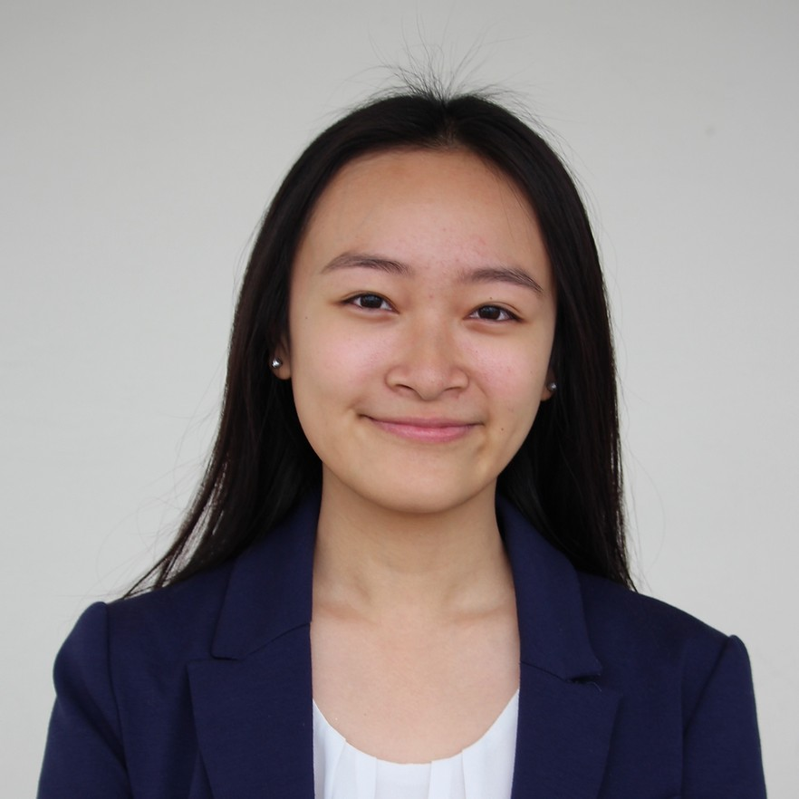
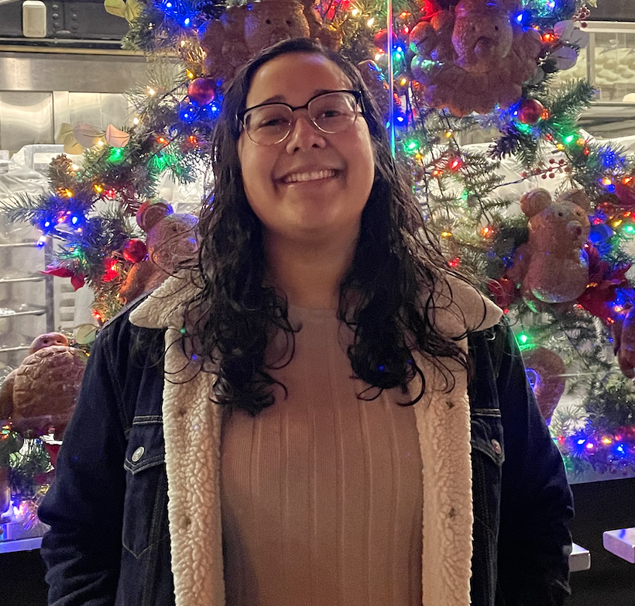
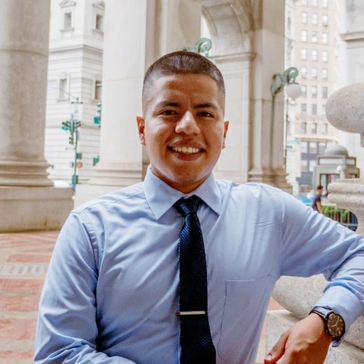
Team Members
Amanda
Anna
Selaine
Wilmer

Slide 3

Value Prop, Problem and Solution Overview
Create an encouraging and immersive language-learning environment for all.

Slide 4
Values Encoded
Equity
We aim to make our learning platform equitable by catering to individuals of all learning backgrounds and differences.
By creating tasks that appeal to different learning forms (listening vs. writing vs. reading), we offer all users a way to interact and succeed.

Slide 5
Values Encoded
Inclusion
We have included people of all backgrounds in our needfinding process so we can ensure that our project does not skew towards the already dominant euro-centric languages.
We are cognizant of centering Indigenous voices and their languages as well as varying countries that speak the same language but all have their own dialects.

Slide 6
Tasks
Notes:
Transition slide

Slide 7
01
Simple Task
Understand: “Comprehend simple phrases in a language of interest.”
Notes:
Note any changes you’ve made from the tasks on the low-fi prototype assignment.

Slide 8
02
Moderate Task
Produce: “Read and write common statements (name, introduction, etc.).”
Notes:
Note any changes you’ve made from the tasks on the low-fi prototype assignment.

Slide 9
03
Complex Task
Engage: “Answer questions and follow instructions (without context clues).”
Notes:
Note any changes you’ve made from the tasks on the low-fi prototype assignment.

Slide 10
Usability Goals and Key Measurements
Memorable
Users should be able to navigate the different tasks and remember what they have accomplished.
Users are aware of their current knowledge, and know what they can retain and what to work on.
We have added a chronological sequence to scaffold the user between different tasks, using their previous experiences in practice in later tasks.
We have added a recap activity, as well as more in-depth user statistics, so users are more aware of what they have learned and what they should remember/work on next time.
Notes:
Memorable
Users can remember the different locations they visited and the language and cultural elements they learned on this mission.
Key Measurements
Easily navigate the different locations and tasks that they have/haven’t visited.
Users are aware of their knowledge breakdown from the statistics page - vocabulary learned, speech levels, countries visited.

Slide 11
Usability Goals and Key Measurements
Learnable
Users should be able to learn more as they progress, building up their language skills gradually.
Vocabulary and knowledge from previous tasks should be practice and re-used to complete later, more complex tasks.
We accomplished this by creating a sequence between our tasks, so users must accomplish the tasks in an order that optimizes their learning.
We brought back vocabulary and knowledge from previous tasks in later tasks but through a different recall message (reading first vs. writing later).
Notes:
Learnable
Users were better able to navigate through the journey when they completed the simpler tasks and ideas before tackling the more complex tasks.
Vocabulary and knowledge from previous tasks were used to complete later tasks.

Slide 12
Interface
Design
Notes:
Transition slide

Slide 13
Major Design Changes
GUIDED TASKS
INTEGRATED HUMAN INTERACTION
BETTER VR SIMULATION
After seeing that users struggled to remember what tasks remaining, we used our mascot, Langu, to provide useful reminders in addition to translations.
Our previous prototype relied more on clicks and actions rather than encouraging users to explore around them.
Previously, we had not included specific people or direct interactions in our adventure.
Notes:
Summarize the three biggest changes we made

Slide 14
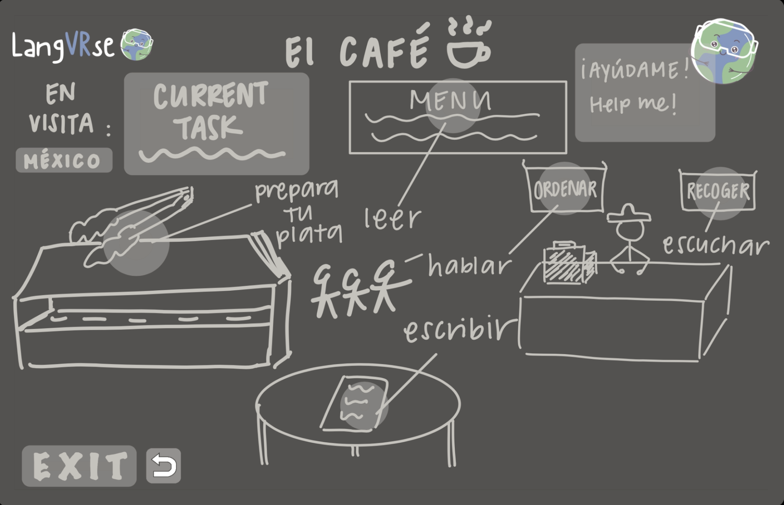
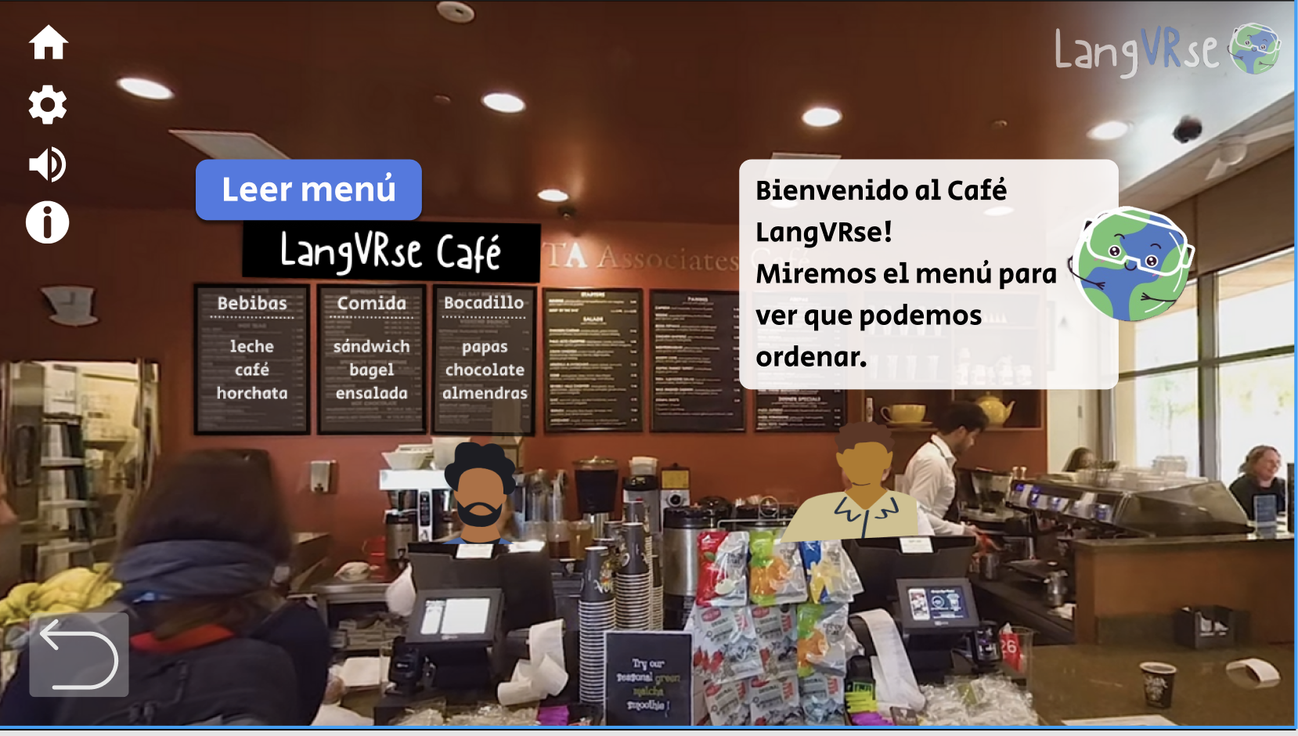
Change #1: Guided Tasks
BEFORE
After
User chose their own tasks from this one page.
User are walked through each task in a specific order.
Notes:
Picture of before and after

Slide 15
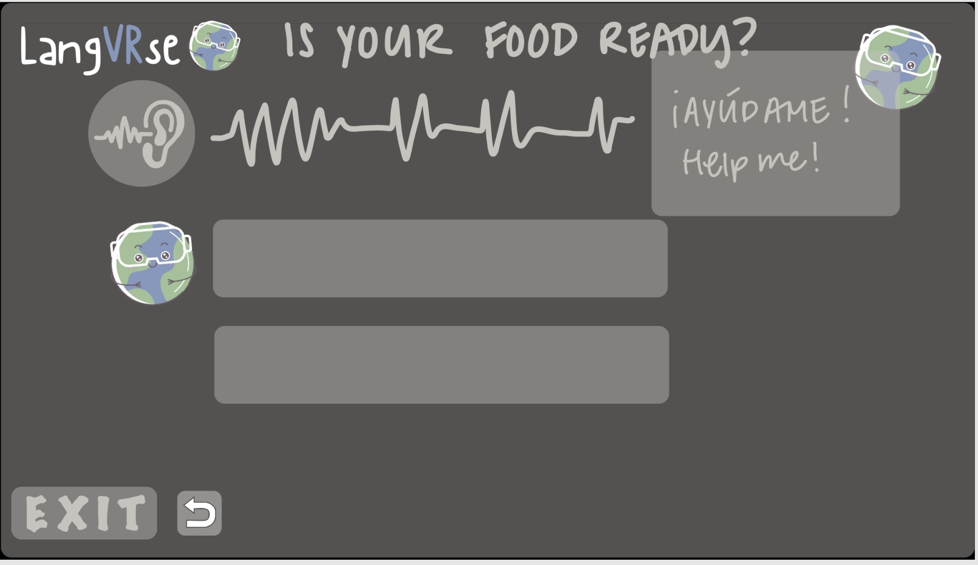
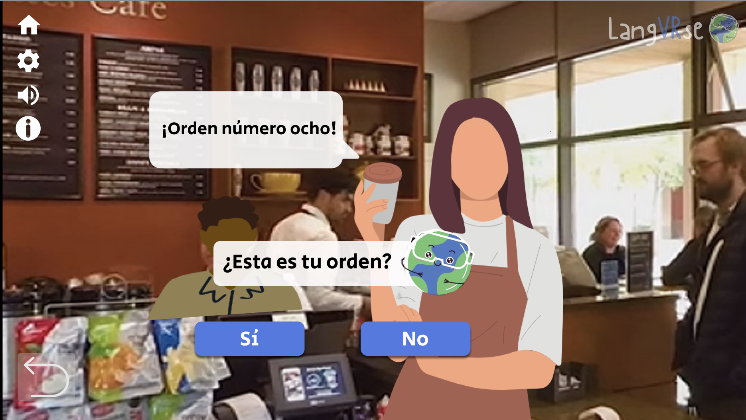
Change #2: Integrated Human Interaction
BEFORE
After
User would hear a phrase but just see sound wave.
User are greeted by the person speaking.
Notes:
Picture of before and after

Slide 16
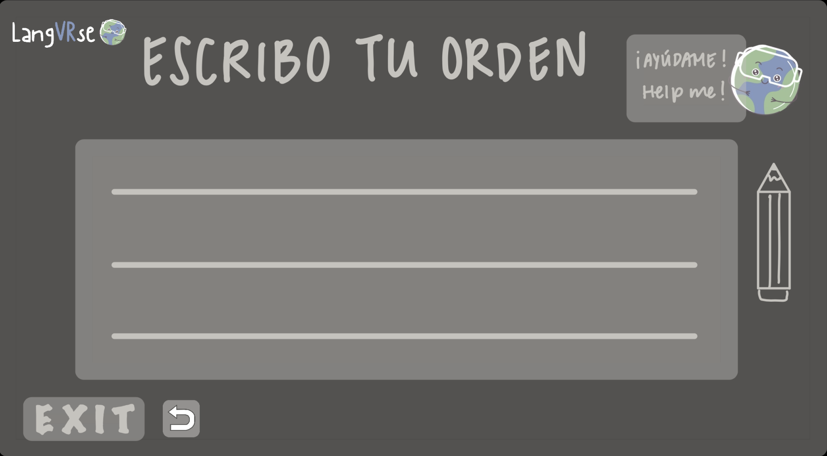
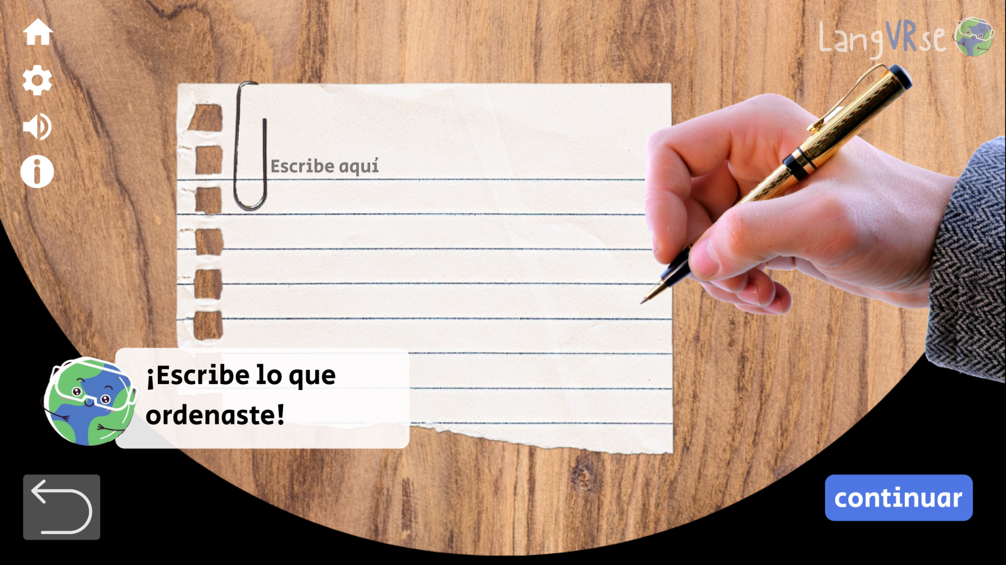
Change #3: Better VR Simulation
BEFORE
After
Experience looked similar to a mobile app (clicking/tapping).
User can better see how they should interact in VR.
Notes:
Picture of before and after

Slide 17

Medium-Fi Prototype Task Flows
Notes:
Transition slide

Slide 18
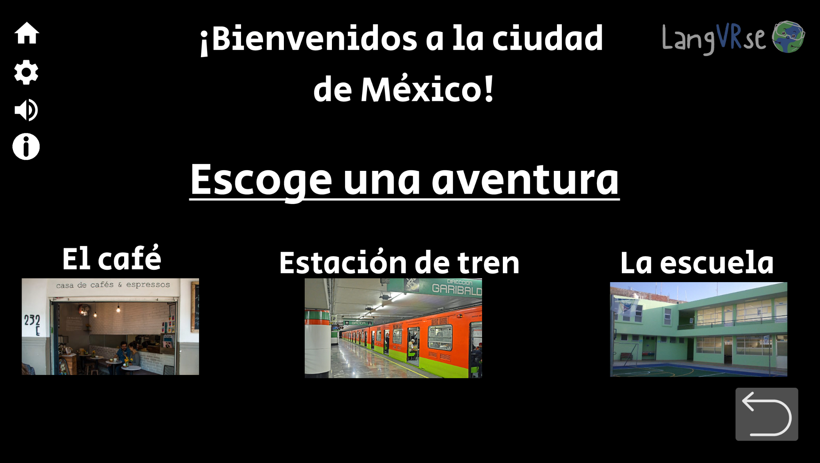
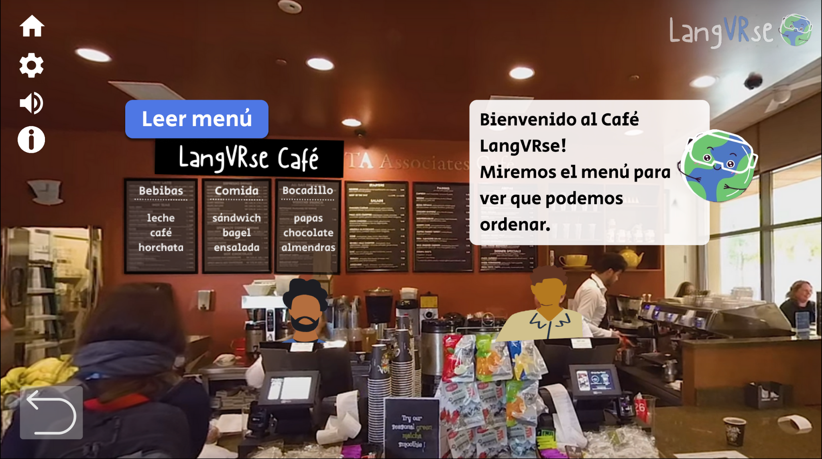
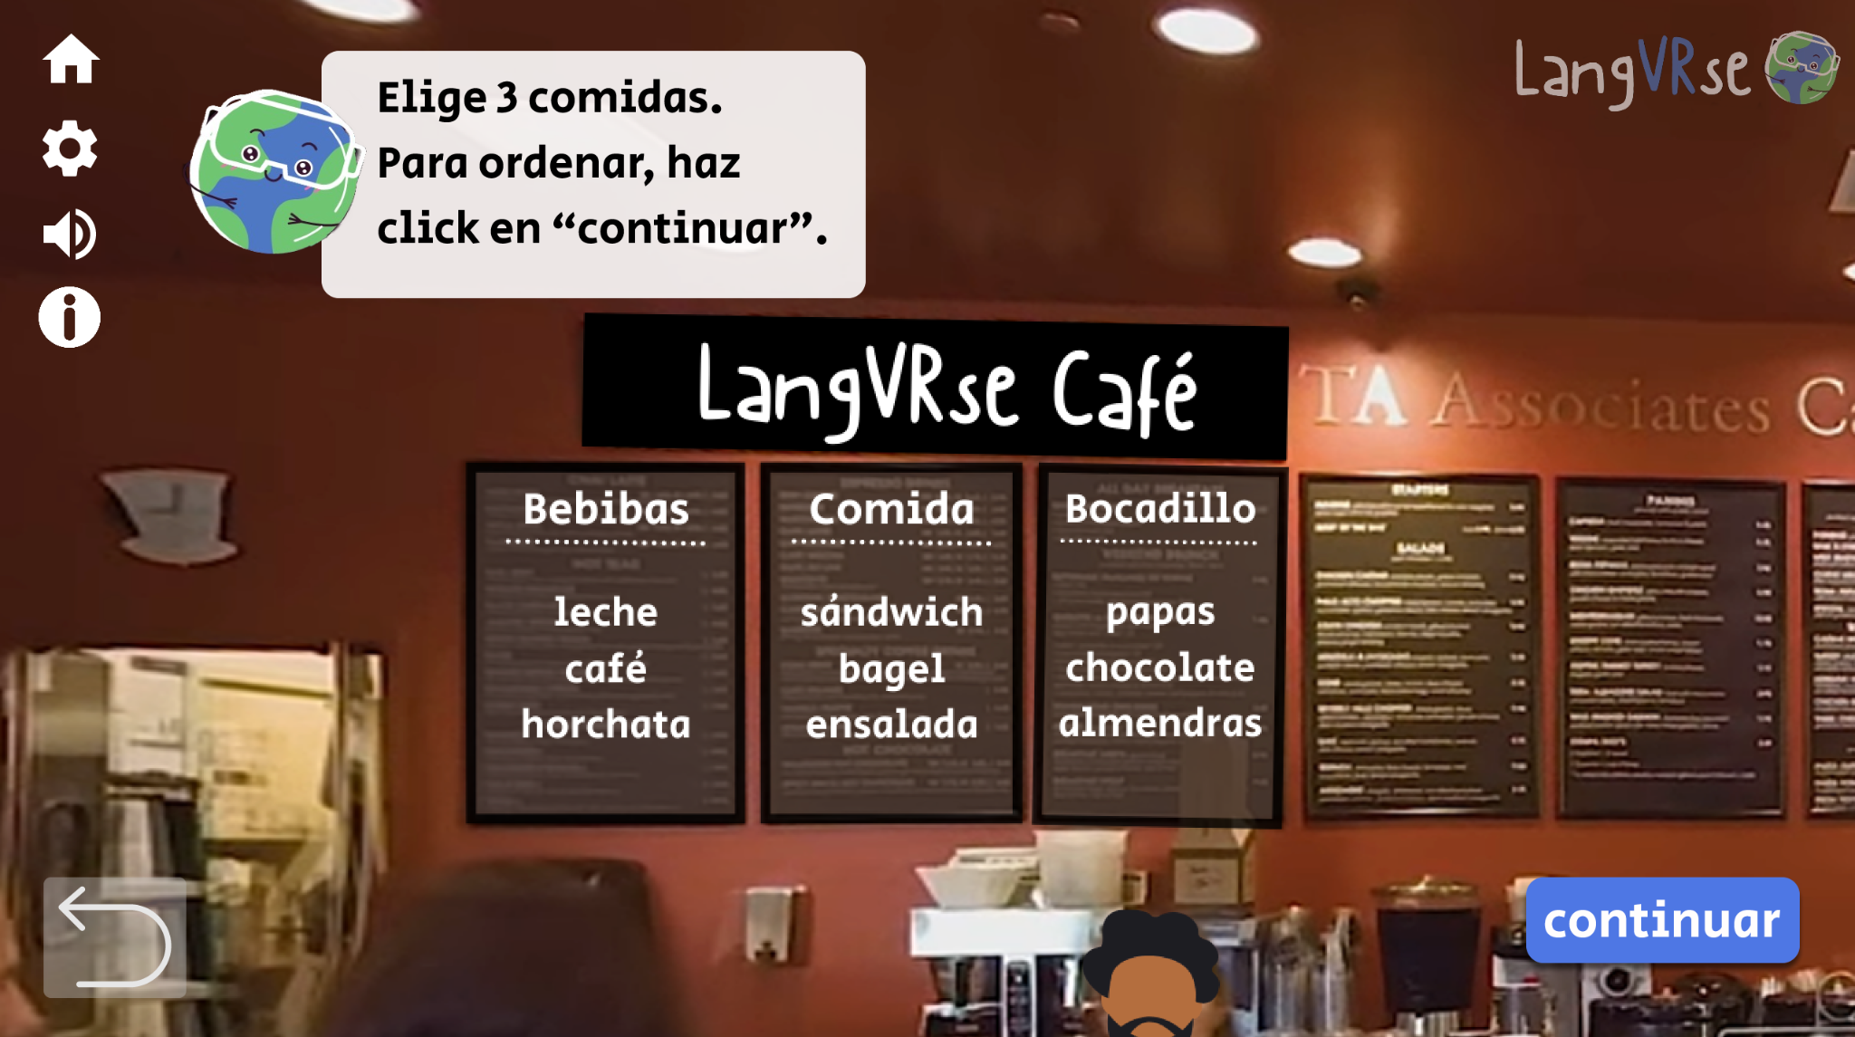
Task Flow #1: Understand Simple Phrases
Users are asked to choose an adventure / place and then are asked to read the menu at the Coffee Shop. They are tasked with understanding the short phrases that lead them through these steps.
Notes:
Screenshots with arrows

Slide 19
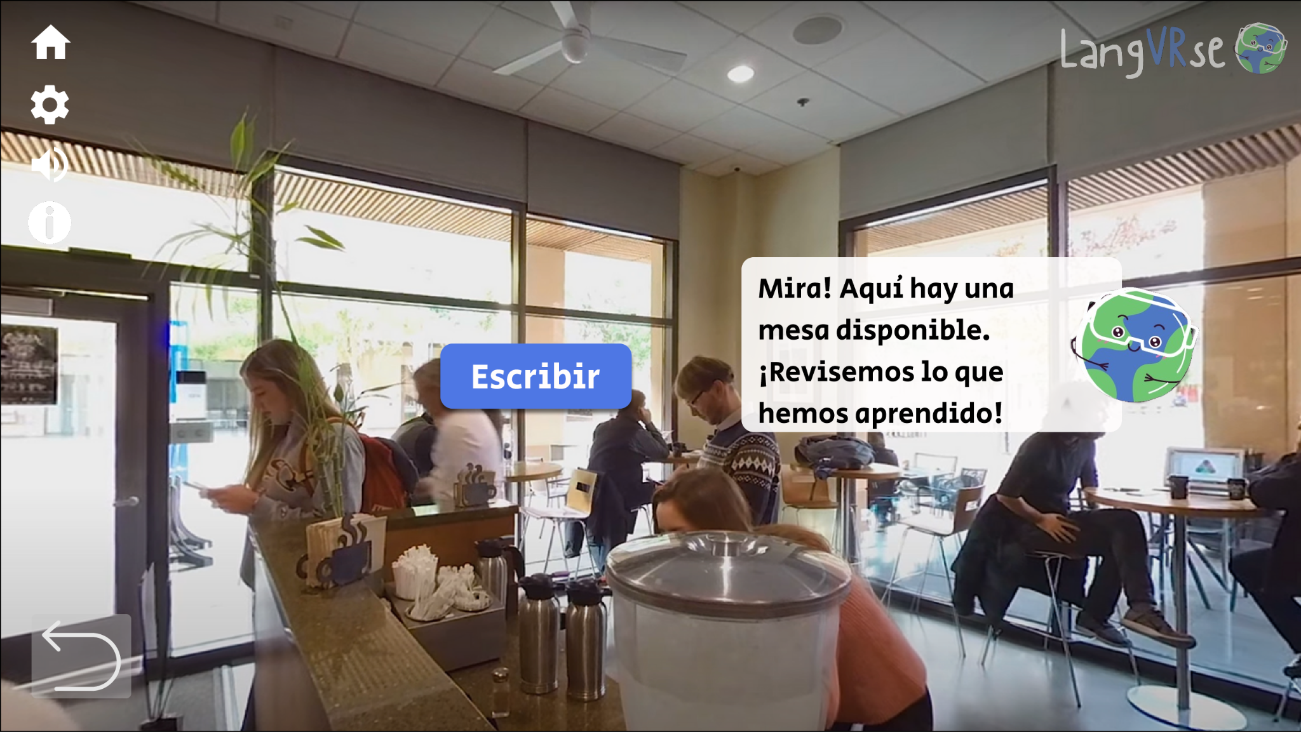
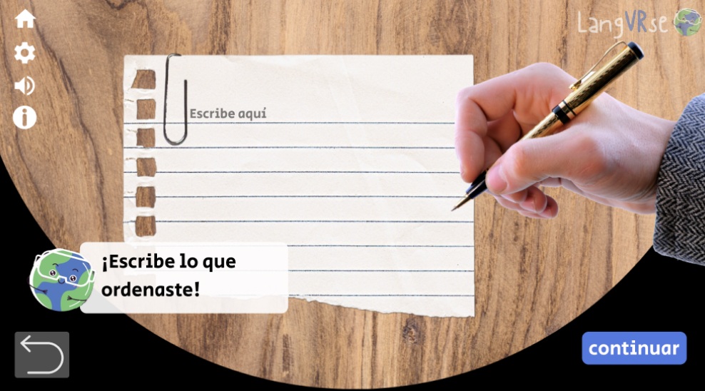
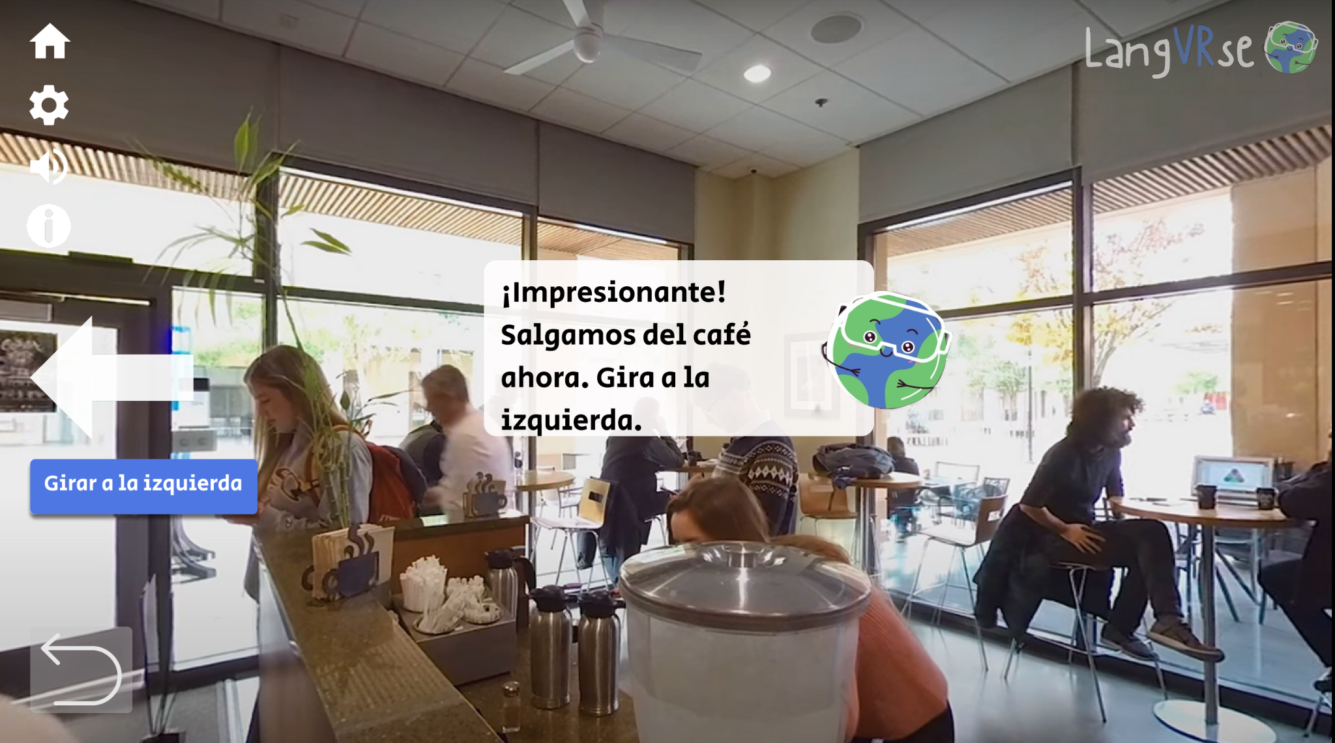
Task Flow #2: Read and Write Common Statements
Users are asked to recall what they have learned by writing down their order. This is a moderate task as they must remember the items they read previously and
Notes:
Screenshots with arrows

Slide 20
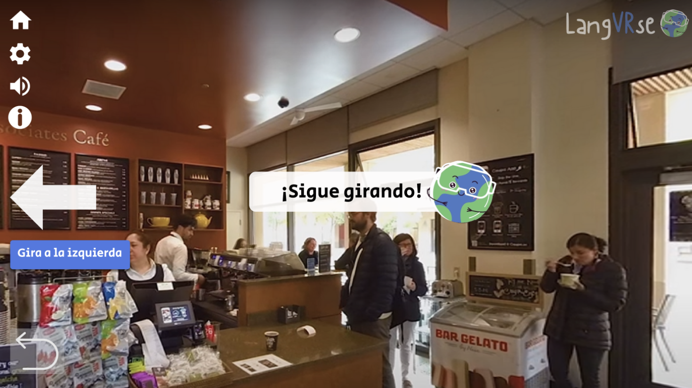
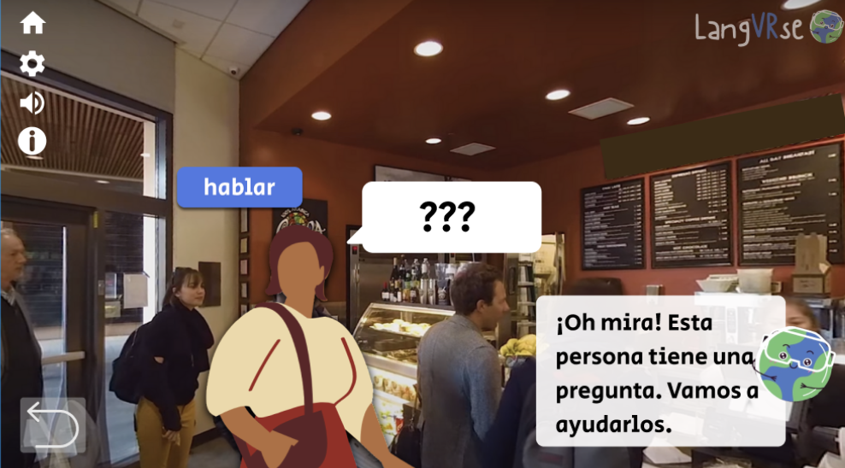
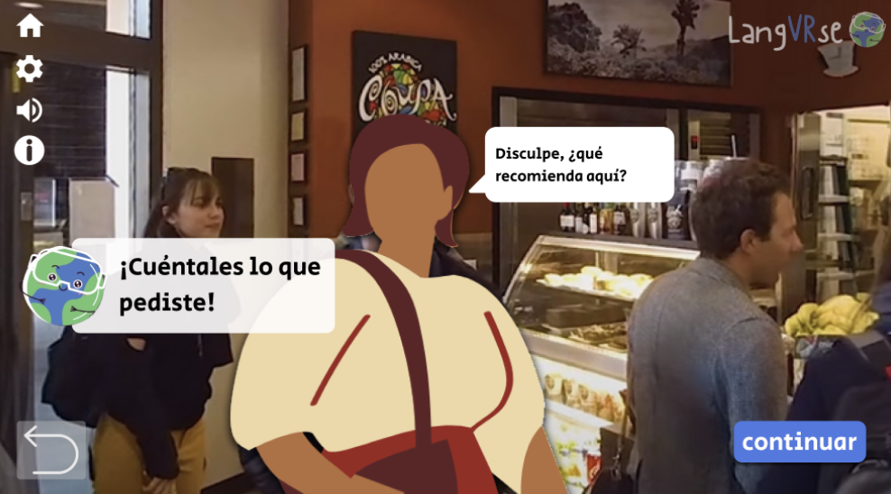
Task Flow #3: Answer Questions and Follow Instructions
Users are asked to follow directional instructions and converse with a person in the cafe who asks them what they recommend. This is a complex task because users must recall what they remember from the menu, practice speaking their order, and hold a conversation in the language they are learning.
Notes:
Screenshots with conversation with stranger
The complex task is a buildup of all the previous tasks the user has completed in this adventure. It uses active recollection and usage of the language with terms they just learned to promote a quick turnaround in learning and applying the language.

Slide 21
Prototype
Overview
Notes:
Transition slide

Slide 22

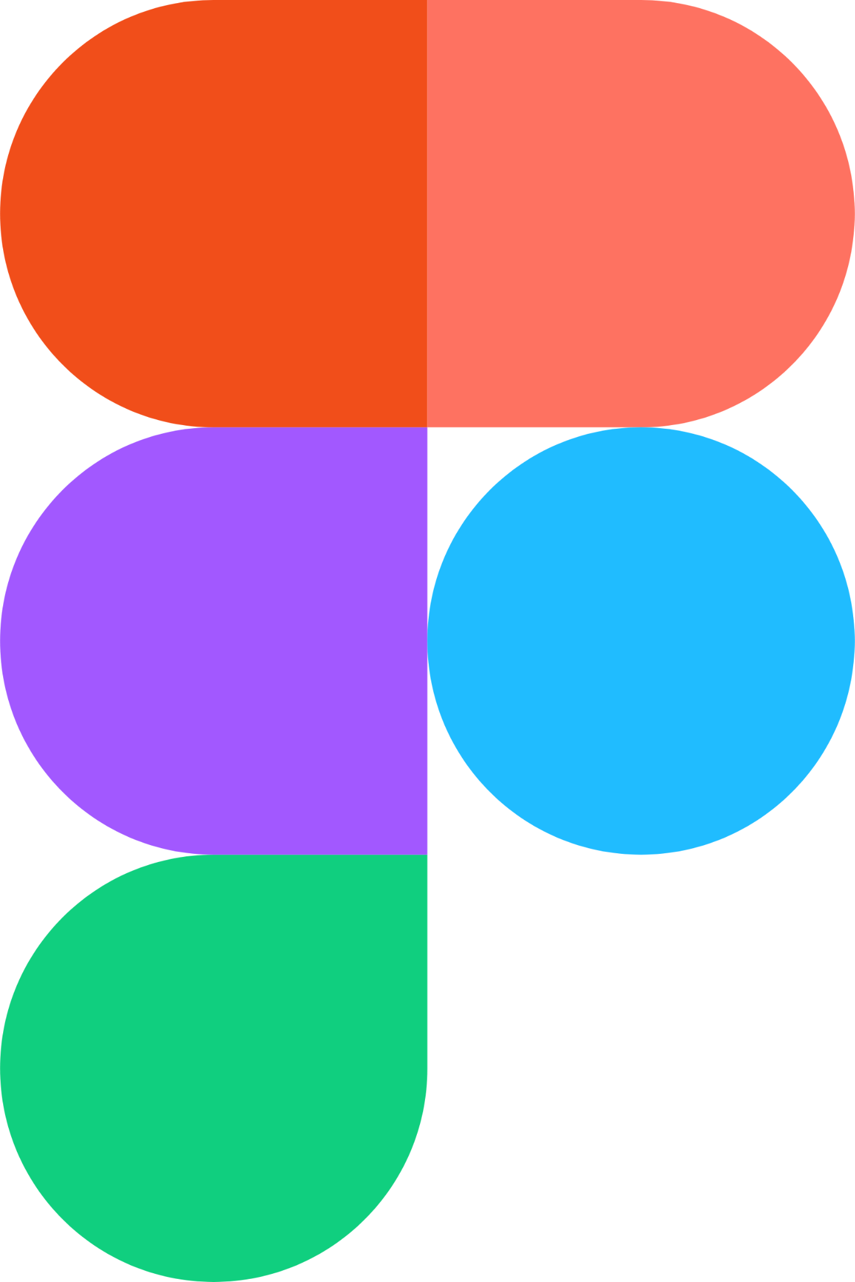
Design / Prototyping Tools
Canva
We utilized this resource for designing our menus and editing the background scenes. We also used this resource for their customizable characters. Nothing was particularly difficult with Canva.
Figma
We ultimately decided to use Figma for ease of convenience and it was free of cost. It was easy to link transition slides but difficult to create authentic VR experiences. We tried to mimic VR movement using ‘look to the right/left’ arrows and smart animations features.
Notes:
- What tools did you use?
- How did the tools help? (what was easy)
- How did the tools not help? (what was hard)
Prezi (considered but didn’t use)
We attempted to use Prezi for the editable graphs, autoplay videos, and zoomable transitions but was limited by the trial length period (15 days), as it wouldn’t allow others to view our prototype to its fullest functionality beyond these days.

Slide 23
Details + Reflections: Limitations/Tradeoffs
It is difficult to replicate VR with still images. Limitations include not being able to integrate sound and audio in the background + autoplay, despite multiple attempts with plug-ins. We opted for smart transitions and alternative methods of engaging with our app.
This prototype only has the option for the user to go to Mexico City and learn Spanish in a cafe. Other adventures can be created easily if we simply translate all existing Spanish screens to a different language, but adventures with different storylines will require a lot of time to develop.
We were also limited by the number of images we could access that had 360-degree rotation and even more so limited by our access to photos of relevant scenes in other countries.
Notes:
Limitations/tradeoffs of the current prototype (what was left out of the prototype & why)
Any Wizard of Oz techniques required to make it work
Hard-coded features and why required

Slide 24
Details + Reflections: Wizard of Oz Techniques
We recommend users to use Zoom and share screen to utilize the ‘Annotate’ feature on Zoom for our writing portions of the tasks.
For the listening parts, we assume that native audio will be played, a feature that we cannot implement with Figma.
We assumed that the left and right buttons would be a representation of movement in VR when a user turns their head/the VR controller buttons.
Notes:
Limitations/tradeoffs of the current prototype (what was left out of the prototype & why)
Any Wizard of Oz techniques required to make it work
Hard-coded features and why required

Slide 25
Details + Reflections: Hard-Coded Features
Some scenes of the adventure show the user’s hand (eg. holding a cup or pen) with a specific skin-color. We hope to create a more inclusive experience by allowing the user to select their skin color and customize their avatar beforehand, something difficult to implement with Figma.
Customizing other parts of adventure based on user selections is difficult in Figma as well, as it would require us to create many additional scenes and collect their audio data. We worked around this in the “order” activity by giving the user a hard-coded order number, rather than attempting to say the items they order aloud.
The backgrounds we used in this prototype are hard-coded still-images, but we hope to later include real movement of characters and audio (background noise) suitable to the setting.
Another hard-coded feature was the user statistics scene. We hope to have an animated stats screen that accurately reflects their progress and allows users to better visualize it.
Notes:
Limitations/tradeoffs of the current prototype (what was left out of the prototype & why)
Any Wizard of Oz techniques required to make it work
Hard-coded features and why required

Slide 26
THANKS!
Do you have any questions?

